Slide 1
Maths
Unit 4 – Addition and Subtraction
22.9.25
WALT:
6Ni.01 – To estimate, add and subtract integers.

Slide 2



WALT: To estimate, add and subtract integers.
With support, I can estimate, calculate and check addition questions.
Independently, I can estimate, calculate and check addition questions.
I can write an explanation that convinces someone estimating and checking are important.

Slide 3
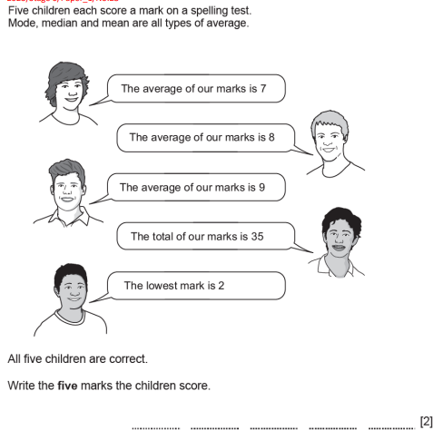
Retrieval Practice
WALT: To estimate, add and subtract integers.
Mean = 7
Median = 8
Mode = 9
2
7
8
9
9

Slide 4
Starter – Sort these numbers
WALT: To estimate, add and subtract integers.
0
Integer | Not an integer
-8
2 ½
5.67
4²
¼
17
3,587

Slide 5
Add together these numbers.
WALT: To estimate, add and subtract integers.
3004
3040
4003
3400
4030
4300
3400
Girls use a calculator
Boys don’t use a calculator

Slide 6
Did you all get the same answer?
WALT: To estimate, add and subtract integers.
3004
3040
4003
3400
4030
4300
3400
What does this show us we need to do before we add large numbers together?

Slide 7
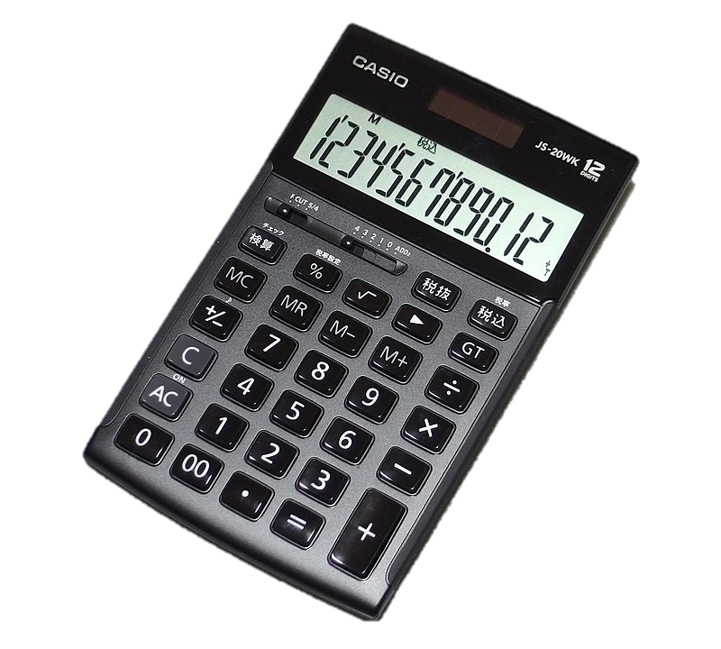
WALT: To estimate, add and subtract integers.
What was quicker, using the calculator or the written method?
Which provided the most accurate results?
Does using a calculator always give the right answer?

Slide 8
Even when using a calculator you must:
WALT: To estimate, add and subtract integers.
Estimate your answer first.
Check your answer.

Slide 9
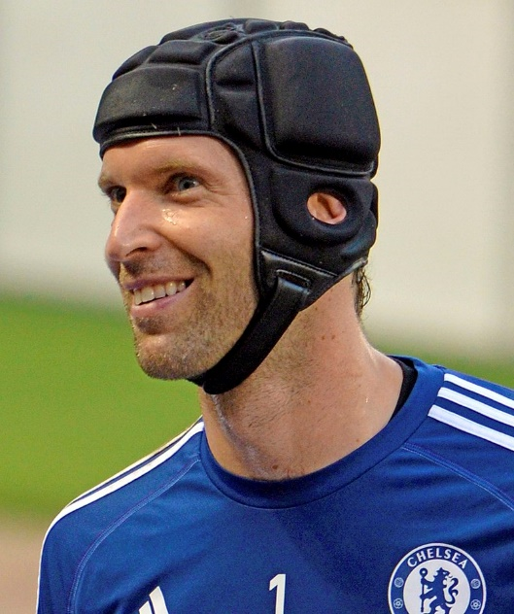
WALT: To estimate, add and subtract integers.
Checking an answer means you do the question again. If you can it is a good idea to use a different method.
If the answer is not the same you need to do the question a third time to see which answer is correct.
Checking is not just looking at the answer.

Slide 10
WALT: To estimate, add and subtract integers.
Check your understanding.
Add together this list of numbers.
6,732 = 7000
4,939 = 5000
3,205 = 3000
1,053 = 1000
5,555 = 6000
6,732 = 7000
9,824 = 10,000
7,832 = 8000
Ms. Giang says estimating and checking are a waste of time.
Write an explanation that convinces her that they are important and useful.
Make sure you:
Estimate
Calculate
Check

Slide 11
WALT: To estimate, add and subtract integers.
With support, I can estimate, calculate and check addition questions.
Independently, I can estimate, calculate and check addition questions.
I can write an explanation that convinces someone estimating and checking are important.

